Slide 1
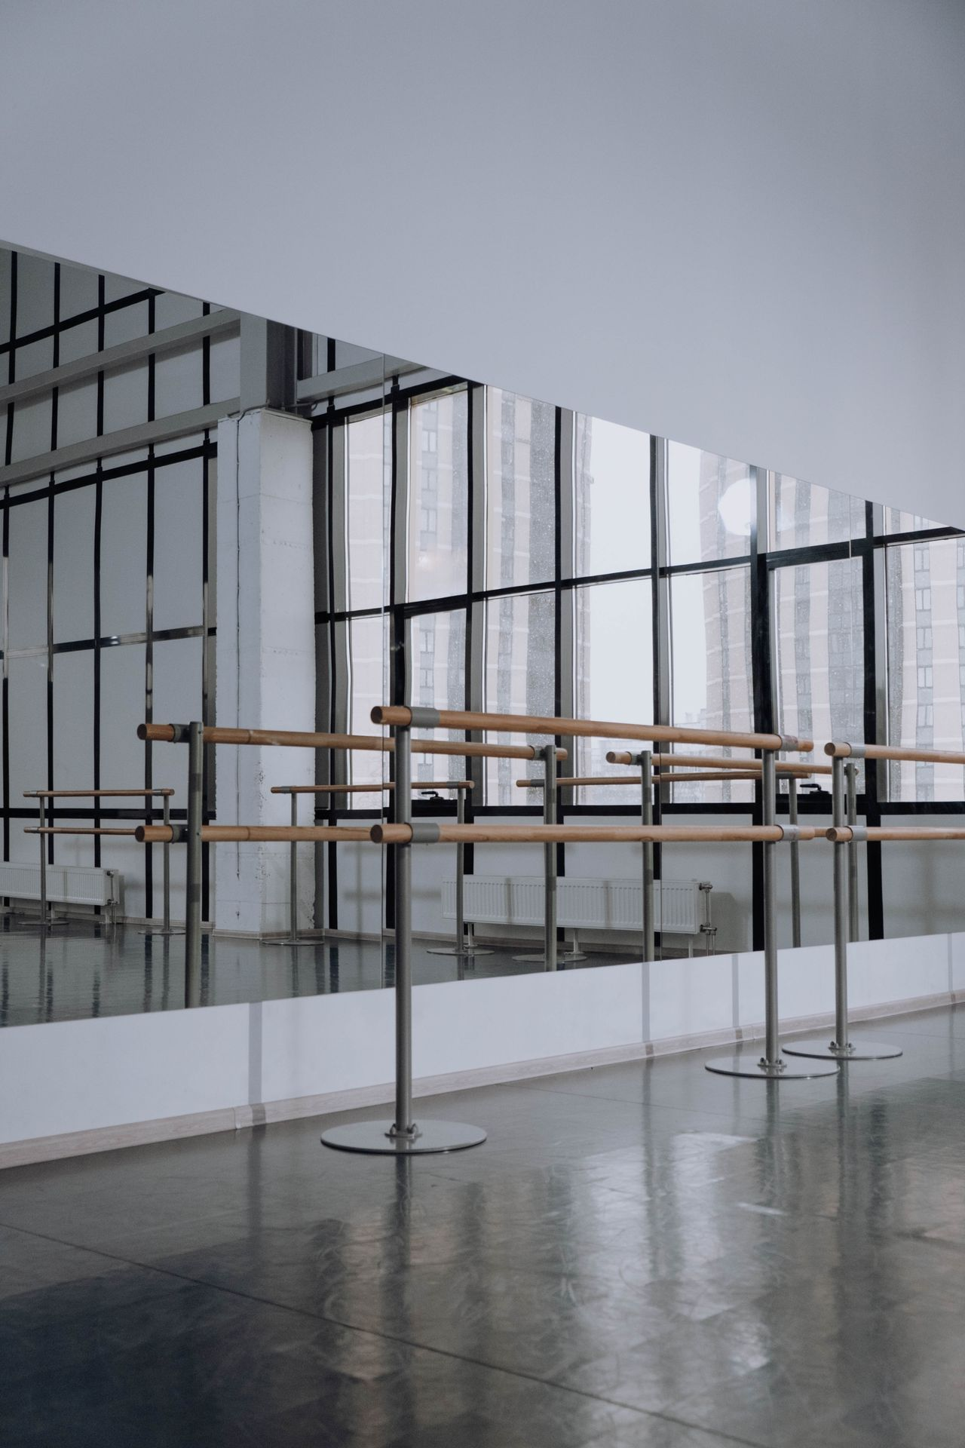
GULF COAST BALLET
Quarterly
Board Review
First quarter of the 2025 to 2026 season. Prepared for the board of directors.

Slide 2
THE QUARTER IN NUMBERS
Where the Company Stands
OPERATING BUDGET
GALA RAISED
SUBSCRIBERS
DONOR RETENTION
6.2M
452,000
3,184
78%
On plan for the season
Goal of 450,000 met
Up 6 percent
Above benchmark
Ticket revenue is tracking to 63 percent of the annual target at the first quarter mark, led by a strong holiday run. Grants are fully committed except for one pending request of 75,000.

Slide 3
OPERATING REVENUE
Revenue Mix, 6.2 Million
A balanced base
Earned ticket revenue and contributed income carry roughly equal weight. Grants and other income round out the budget. The board target is to hold earned revenue at or above 40 percent.

Slide 4
OPERATING EXPENSES
Where the Budget Is Spent

Slide 5
BOX OFFICE
Monthly Ticket Revenue, Season to Date

Slide 6
FACILITIES AND DECISIONS
Open Items for the Board
Studio 3 sprung floor
Warped section replaced and closed at 8,500 dollars. Back in full rehearsal use.
Principal contracts
Three renewals for the new season, a combined increase of 15,000 dollars.
Pending grant
A 75,000 dollar request for the new work, decision expected in October.
Shared venue schedule
Coordination with Bayou City Opera confirmed through the spring.

